Slide 1
Round Trip Time (RTT)
Dr.Mohammed Abdalla Mahmoud Youssif
1

Slide 2

2
Notes:
2

Slide 3
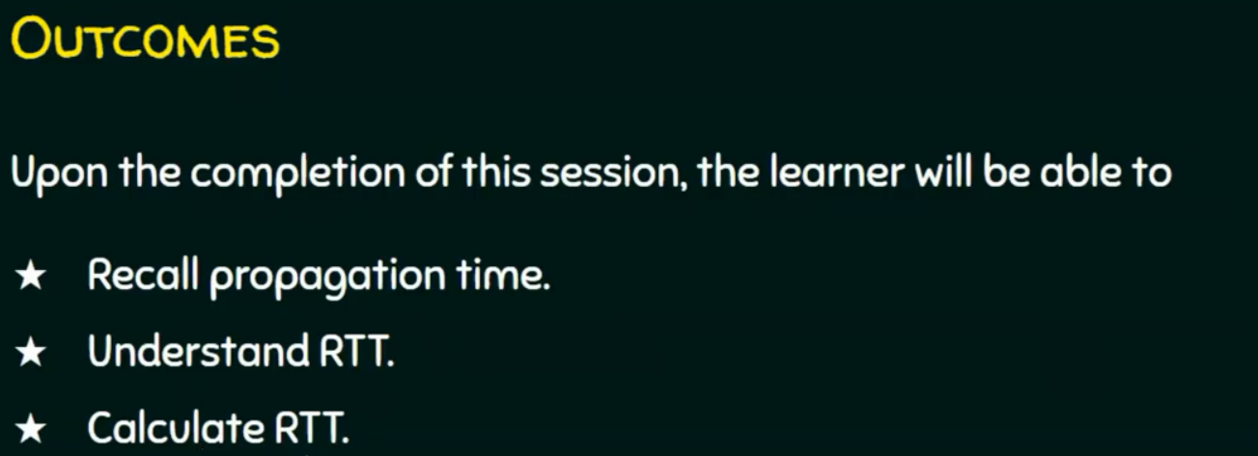
3
Notes:
3

Slide 4
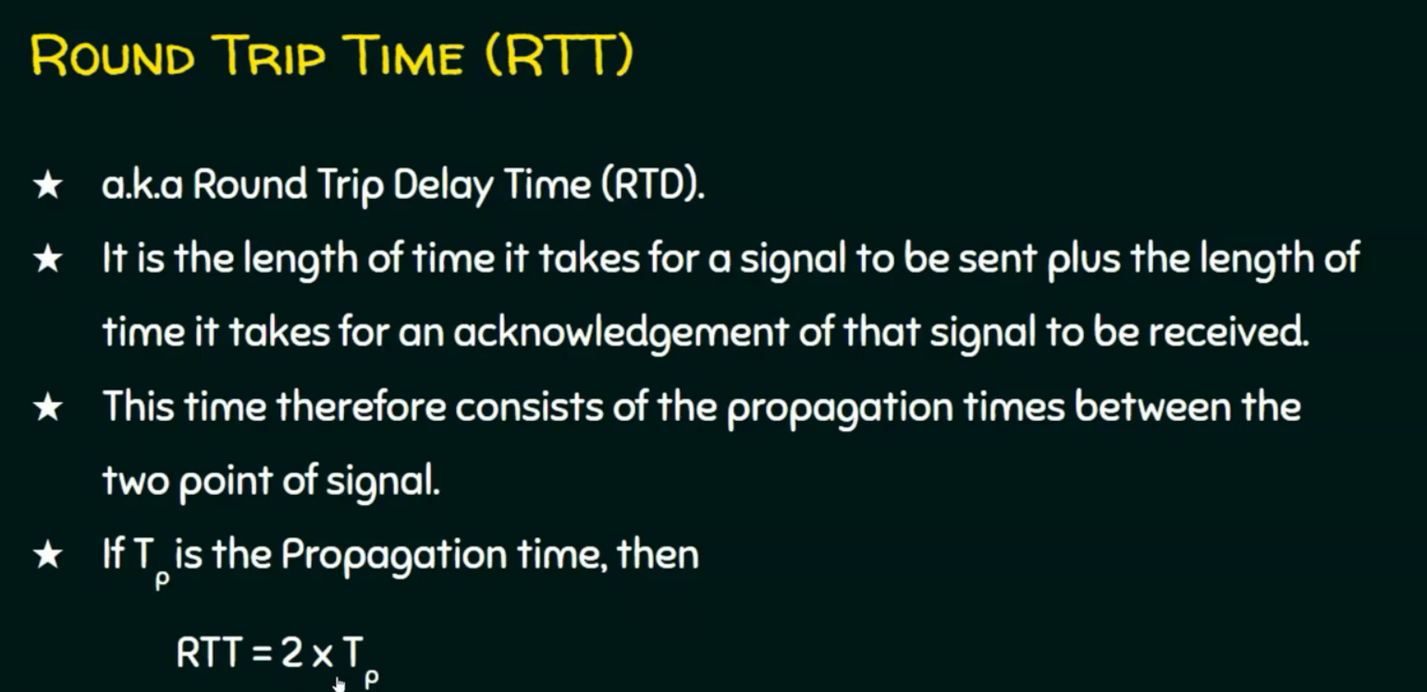
4
Notes:
4

Slide 5
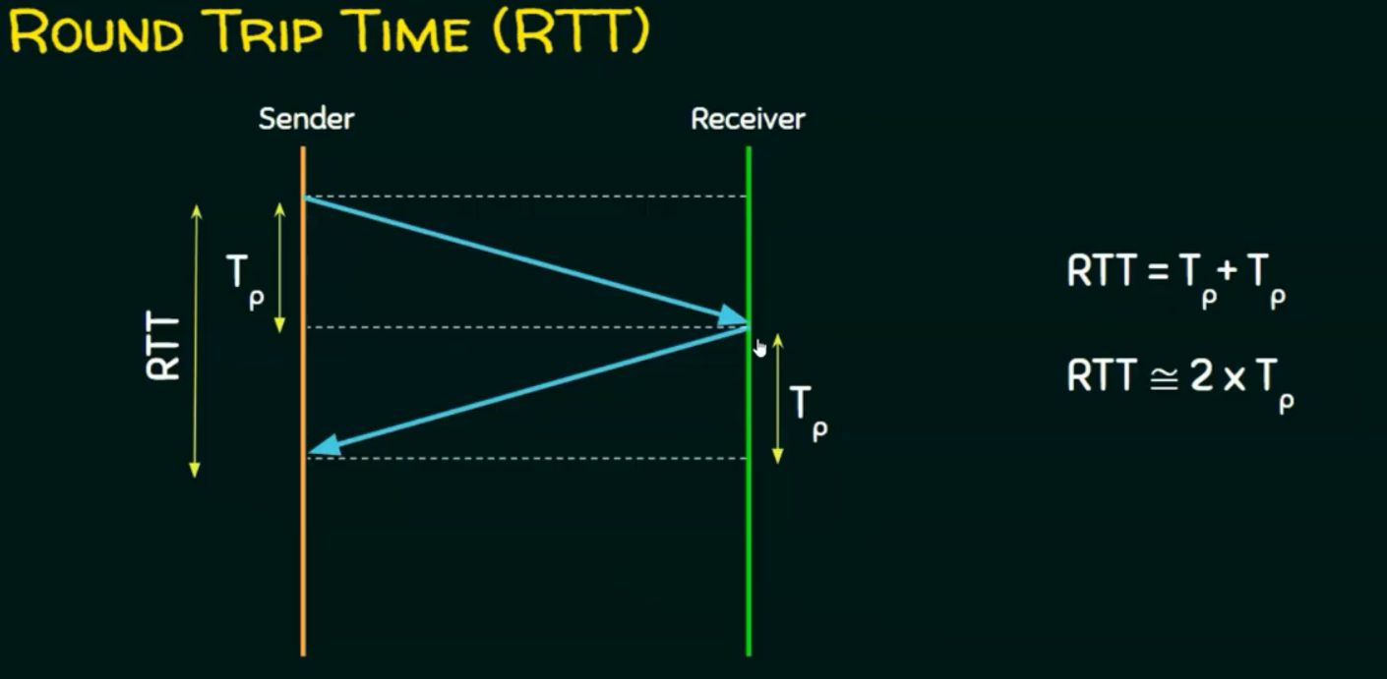
5
Notes:
we say approximately = 2* Tp because the time of sending is not same as time of receiving , but we consider they are same.
5

Slide 6
Questions ?
6
Notes:
6

